Slide 1

Final Year Project on Skin disease Detection using convolutional neural network
Hindustan College of Science and Technology, Farah, Mathura
Department of Information Technology
Project Guide:
Dr. Shankar Thawkar
Member:
1.Himanshu Moolchandani
(1900640130002)
2. Kunal
(1900640130004)
3. Vivek (1900640130008)

Slide 2
Introduction:
Skin diseases are conditions that affect your skin. These diseases may cause rashes, inflammation, itchiness or other skin changes.
My goal is predict skin disease just by clicking a photo to get a particular disease like Acne , Alopecia areata , Eczema , Skin cancer , Nail fungus .
A convolutional neural network (CNN) is a type of neural network that is commonly used in computer vision and image recognition tasks.
It is composed of multiple layers of interconnected neurons, where each layer is responsible for extracting a different set of features from the input data.

Slide 3
Feasibility Study
Three Tests for Feasibility :-
Technical Feasibility :
It is a measure of the practicality of a specific technical solution and the availability of technical resources and expertise.
In our project we need minimum i3 processor, 4GB RAM (min) & 16GB or higher System 32 or 64 bit, Windows 7 or higher. Hard disk 512GB (min) which are available. Therefore, this project is Technically feasible.

Slide 4
Operational Feasibility :
It is a measure of how well the solution of problems or a specific solution will work in the Project. It is also a measure of how people feel about the system/project.
In this project the Algorithm (CNN , Machine learning library like TensorFlow ,Keras etc.) and Techniques that we our using there resources are available so we can make this project Operational i.e. this project is Operationally Feasible.
Economical Feasibility:
It is a measure of the cost-effectiveness of a project or solution. This is often called a cost-benefit analysis.
As above we seen in Technical and Operational feasibility currently we do not need to purchase any hardware, Software or Resources we can get them by some open sources. Therefore, this project is Economically Feasible.

Slide 5
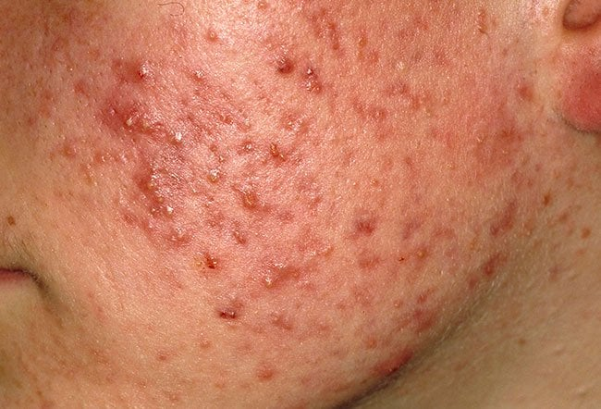
SKIN DISEASE DATASET
These Five disease database download from Kaggle are :
Acne is a common skin condition where the pores of your skin become blocked by hair, sebum (an oily substance), bacteria and dead skin cells.

Slide 6
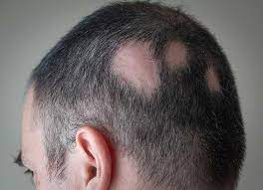
SKIN DISEASE DATASET
Alopecia areata is a condition that causes a person's hair to fall out. (Alopecia is the medical term for hair loss; there are various types of alopecia, including alopecia areata).

Slide 7
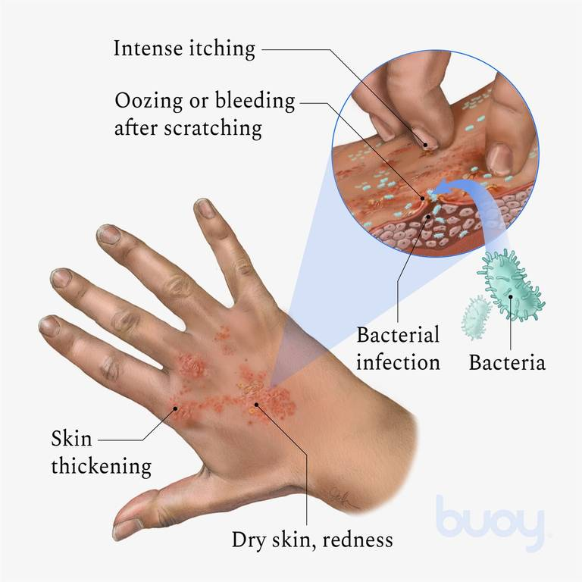
SKIN DISEASE DATASET
Eczema (also called atopic dermatitis) is a condition that causes your skin to become dry, red, itchy and bumpy. It’s one of many types of dermatitis. Eczema damages the skin barrier function (the "glue" of your skin). This loss of barrier function makes your skin more sensitive and more prone to infection and dryness.

Slide 8
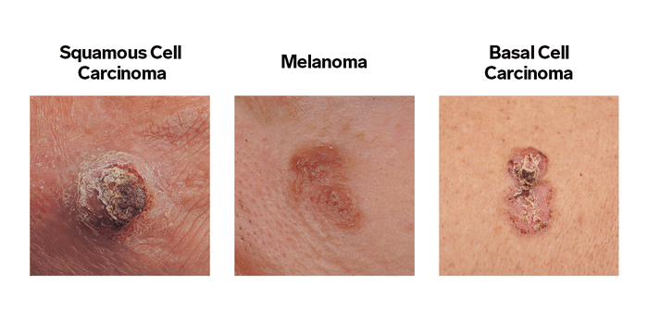
SKIN DISEASE DATASET
Skin cancer is often caused by ultraviolet (UV) light exposure from the sun. There are three main types of skin cancer:
Basal cell carcinoma.
Squamous cell carcinoma.
Melanoma.

Slide 9
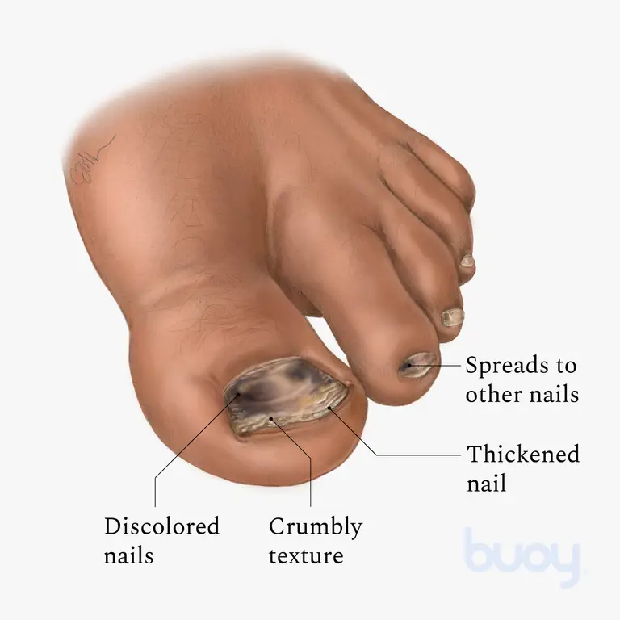
SKIN DISEASE DATASET
Nail fungus is a common infection of the nail. It begins as a white or yellow-brown spot under the tip of your fingernail or toenail. As the fungal infection goes deeper, the nail may discolor, thicken and crumble at the edge. Nail fungus can affect several nails.
Black Toenail Fungus

Slide 10
Iterative Waterfall Model
In a practical software development project, the classical waterfall model is hard to use.
Once defect is detected, the engineers need to go back to the phase where the defects had occurred and redo some work done during that phase and the subsequent phases to correct the defects and its effect on the latter phases.
Therefore a feedback path is needed in the classical waterfall model from every phase to its preceding phase.
So, Iterative waterfall model can be thought of as incorporating the necessary changes to the classical waterfall model to make it usable in practical software development projects.
This also referred as Modified Waterfall Life-Cycle Model.

Slide 11
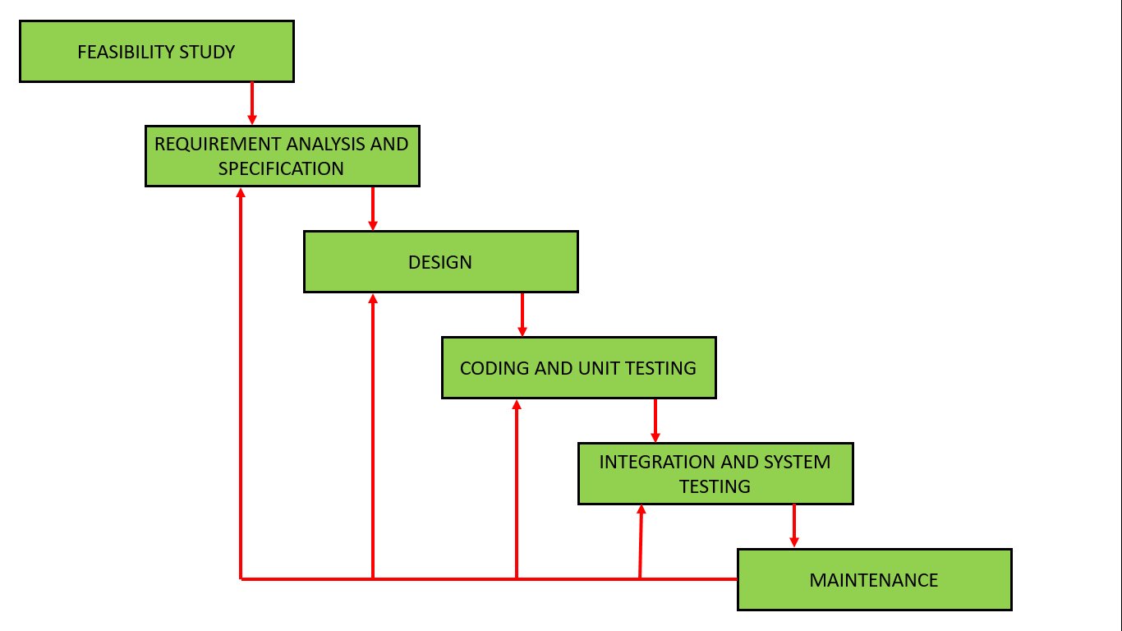
Iterative Waterfall Model

Slide 12
Advantages of Iterative Waterfall Model
Feedback Path: In the classical waterfall model, there are no feedback paths, so there is no mechanism for error correction.
Simple: Iterative waterfall model is very simple to understand and use. That's why it is one of the most widely used software development models.
Less time is spent on documenting & more on designing.
Allows the team to find functional or design related flaws as early as possible.

Slide 13
Disadvantages of Iterative Waterfall Model
Difficult to incorporate change requests: The major drawback of the iterative waterfall model is that all the requirements must be clearly stated before starting of the development phase. Customer may change requirements after some time but the iterative waterfall model does not leave any scope to incorporate change requests that are made after development phase starts.
Incremental delivery not supported: In the iterative waterfall model, the full software is completely developed and tested before delivery to the customer. There is no scope for any intermediate delivery. So, customers have to wait long for getting the software.
Overlapping of phases not supported: Iterative waterfall model assumes that one phase can start after completion of the previous phase, But in real projects, phases may overlap to reduce the effort and time needed to complete the project.
Risk handling not supported: Projects may suffer from various types of risks. But, Iterative waterfall model has no mechanism for risk handling.

Slide 14
Data Flow Diagram(DFD)
Level 0 :The DFD Level 0 depicts the users to input the image of the Skin . The system in turn detects and recognizes the Skin disease.
Skin disease detection and recognition
USER

Slide 15
Level 1 : The CNN model takes the image from the training dataset and then CNN model predicts the type of disease of the Skin disease.
USER
Skin disease
prediction
Training Dataset
CNN Model

Slide 16
Level 2 :DFD Level 2 goes one step deeper into parts of 1-level DFD.It can be used to plan or record the specific/necessary detail about the system’s functioning.
Setting heigth and weight of image
USER
Processing of the images by CNN layers
Prediction of disease

Slide 17
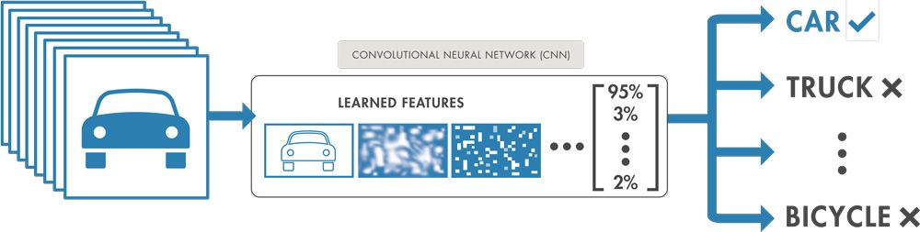
Convolutional Neural Network Algorithm:
A convolutional neural network (CNN or ConvNet), is a network architecture for deep learning which learns directly from data, eliminating the need for manual feature extraction.
CNNs are particularly useful for finding patterns in images to recognize objects, faces, and scenes. They can also be quite effective for classifying non-image data such as audio, time series, and signal data.
Applications that call for object recognition and computer vision — such as self-driving vehicles and face-recognition applications — rely heavily on CNNs.

Slide 18
.
These layers perform operations that alter the data with the intent of learning features specific to the data. Three of the most common layers are: convolution, activation or ReLU, and pooling.
Convolution puts the input images through a set of convolutional filters, each of which activates certain features from the images.
Rectified linear unit (ReLU) allows for faster and more effective training by mapping negative values to zero and maintaining positive values. This is sometimes referred to as activation, because only the activated features are carried forward into the next layer.
Pooling simplifies the output by performing nonlinear downsampling, reducing the number of parameters that the network needs to learn.

Slide 19
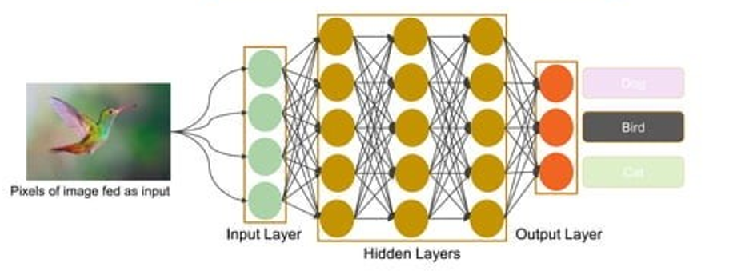
How image recognition work ?

Slide 20
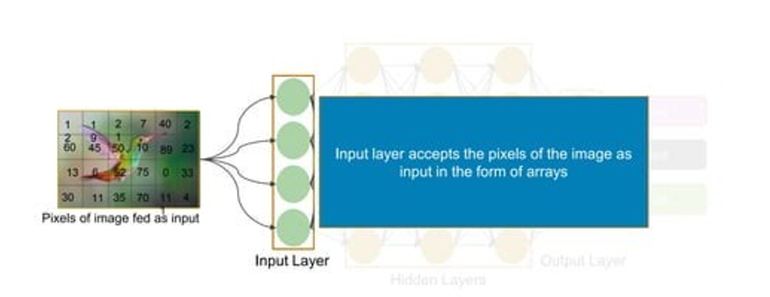
How image recognition work ?

Slide 21
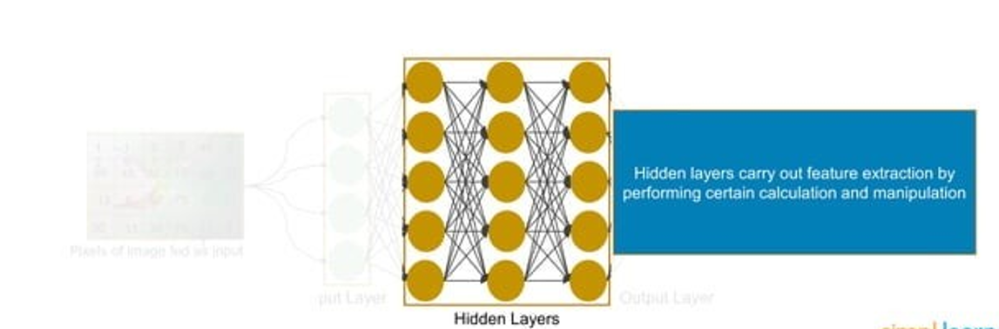
How image recognition work ?

Slide 22
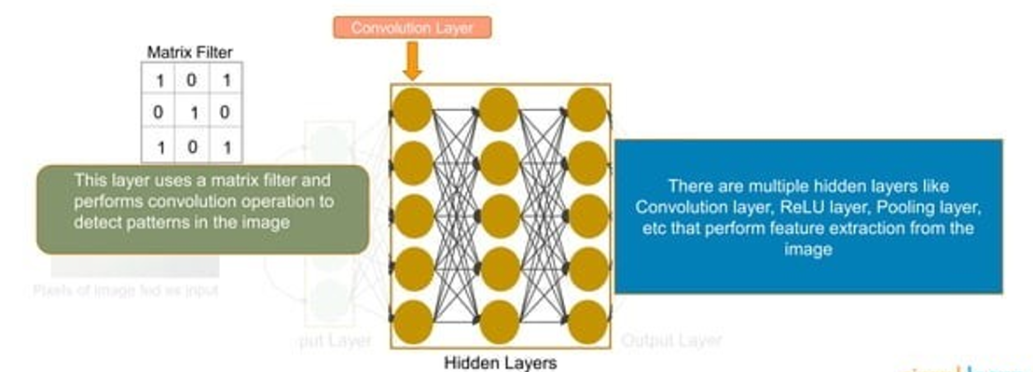
How image recognition work ?

Slide 23
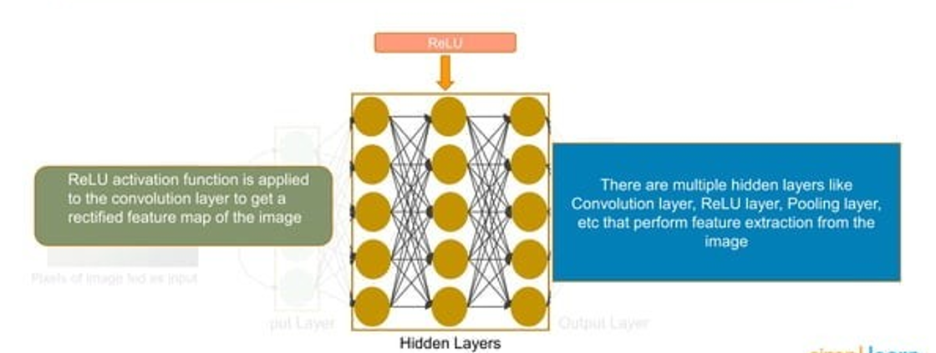
How image recognition work ?

Slide 24
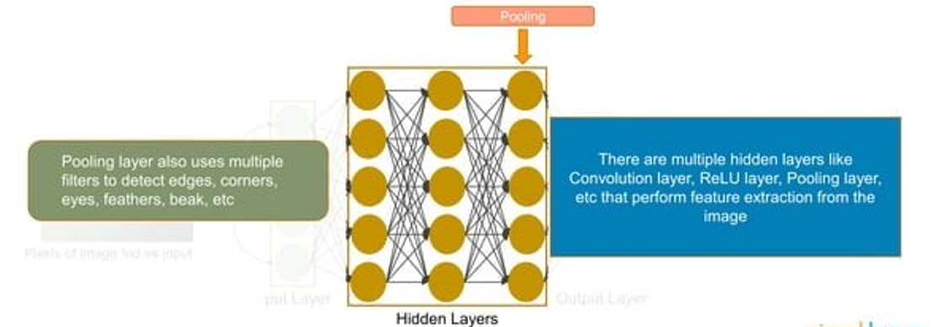
How image recognition work ?

Slide 25
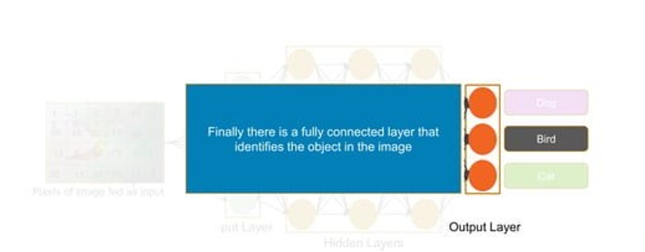
How image recognition work ?

Slide 26
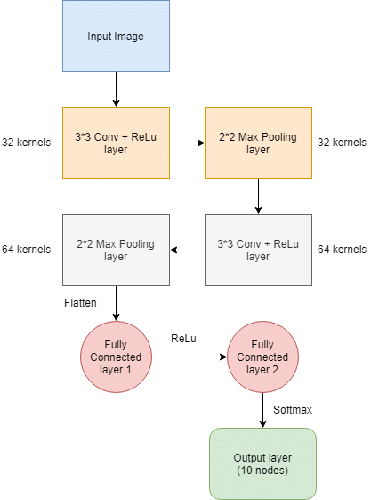
System Architecture

Slide 27
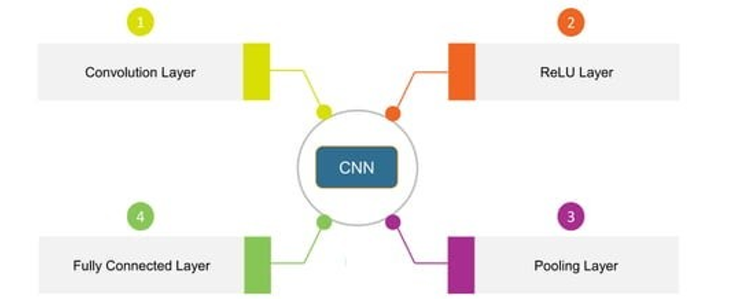
Detail Description Layer In CNN

Slide 28
Convolutional Layer
In a CNN (Convolutional Neural Network), a convolutional layer is a type of layer that performs a convolution operation on the input data. This operation involves applying a filter to the input data, which helps to extract useful features and patterns from the data. The convolutional layer is a key component of a CNN, and it is typically followed by other types of layers such as pooling and fully-connected layers. These layers work together to process the input data and produce an output that can be used for various tasks such as image classification or object detection.

Slide 29
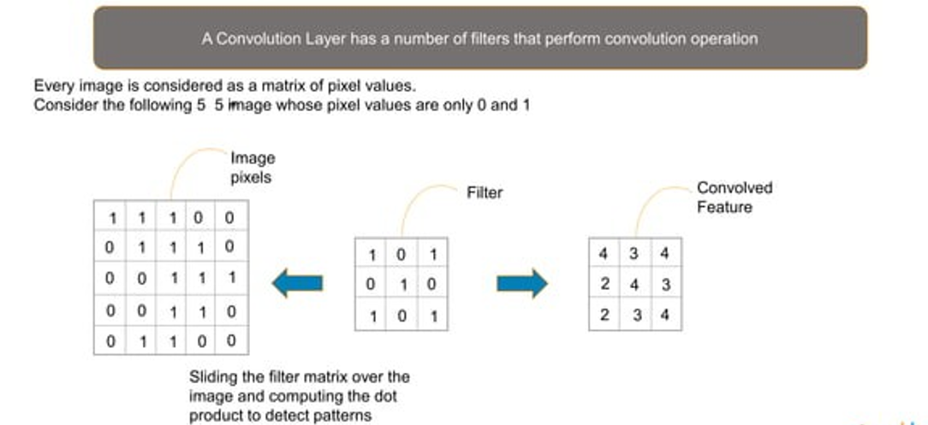
Convolutional Layer

Slide 30
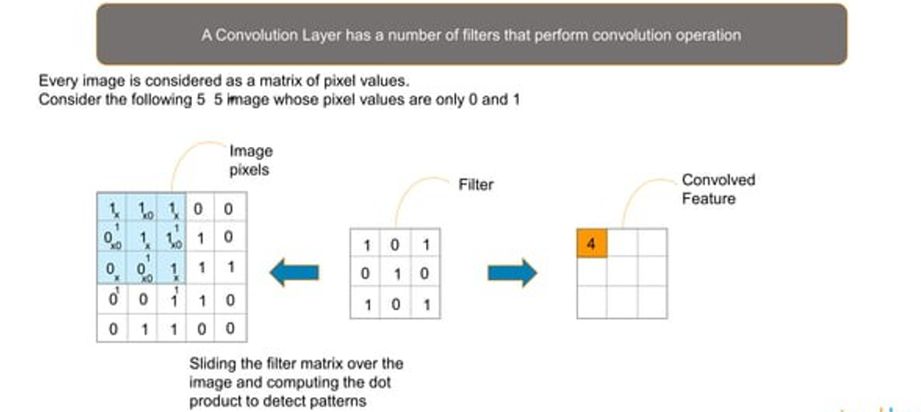
Convolutional Layer

Slide 31
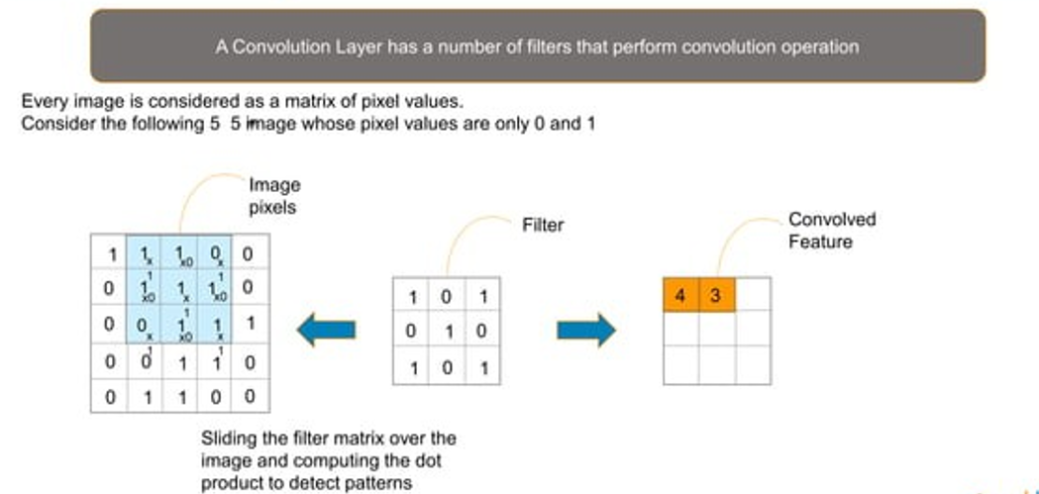
Convolutional Layer

Slide 32
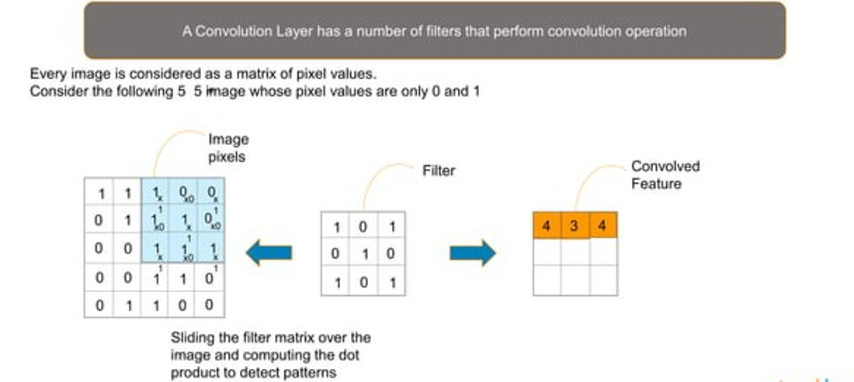
Convolutional Layer

Slide 33
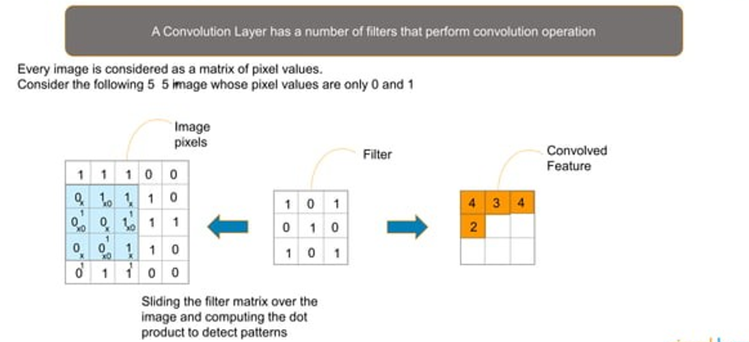
Convolutional Layer

Slide 34
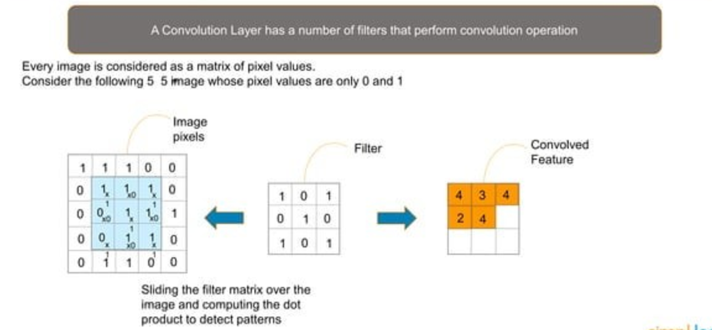
Convolutional Layer

Slide 35
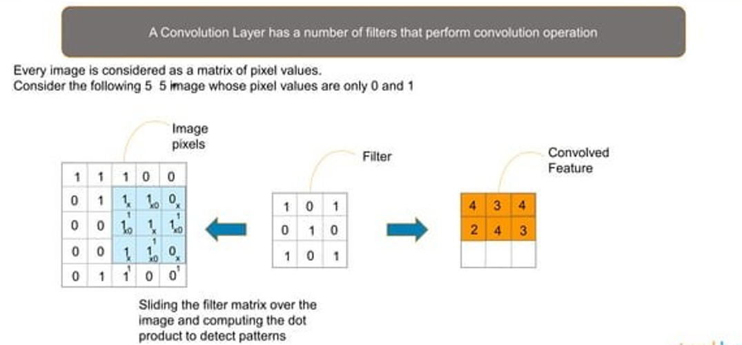
Convolutional Layer

Slide 36
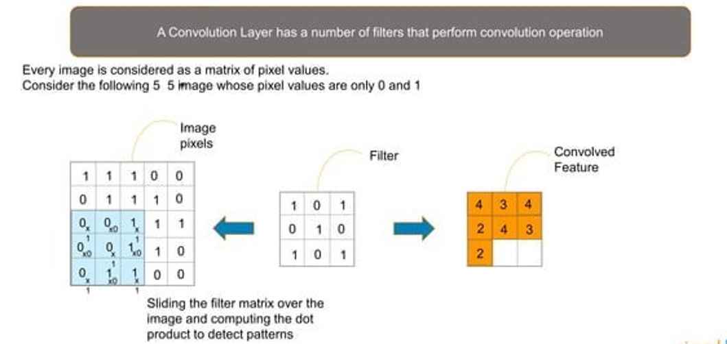
Convolutional Layer

Slide 37
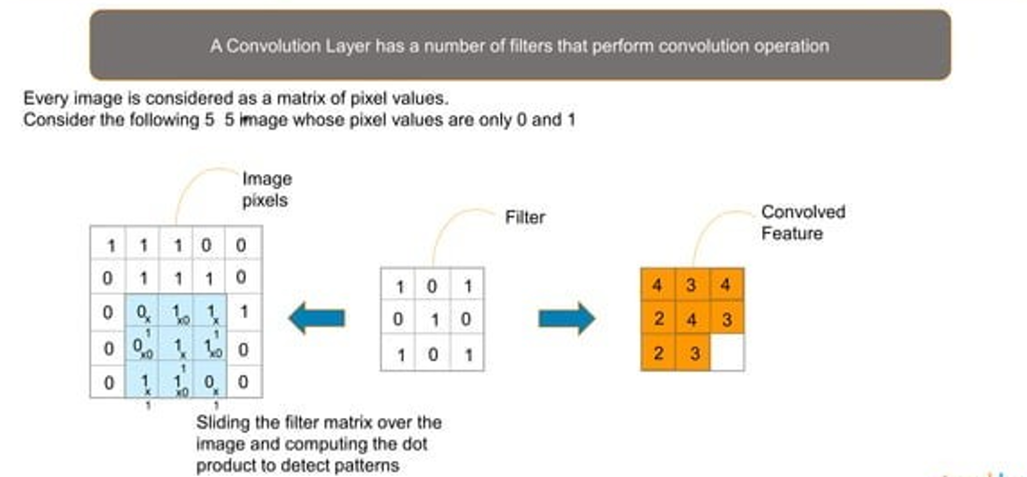
Convolutional Layer

Slide 38
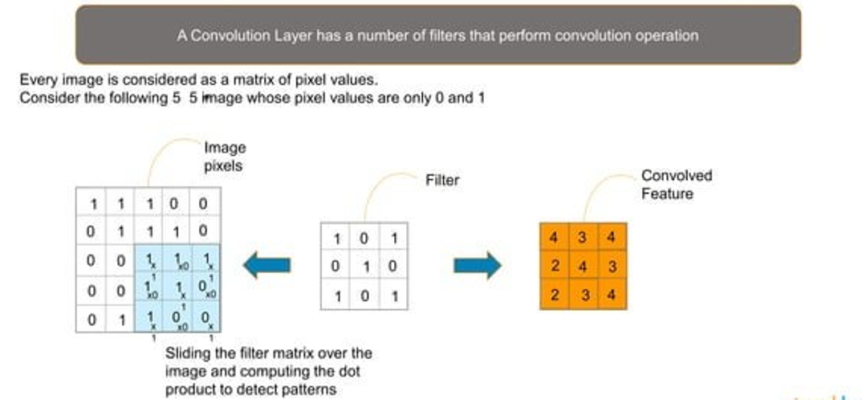
Convolutional Layer

Slide 39
ReLU Layer
In a CNN (Convolutional Neural Network), a ReLU (Rectified Linear Unit) layer is a type of layer that applies the ReLU activation function to the input data. The ReLU activation function is a simple mathematical function that replaces all negative values in the input data with zeros, while leaving the positive values unchanged. This has the effect of "rectifying" the input data and allowing the network to learn more complex and non-linear patterns in the data. The ReLU layer is often used after the convolutional and pooling layers in a CNN, and it can help to improve the performance and efficiency of the network.

Slide 40
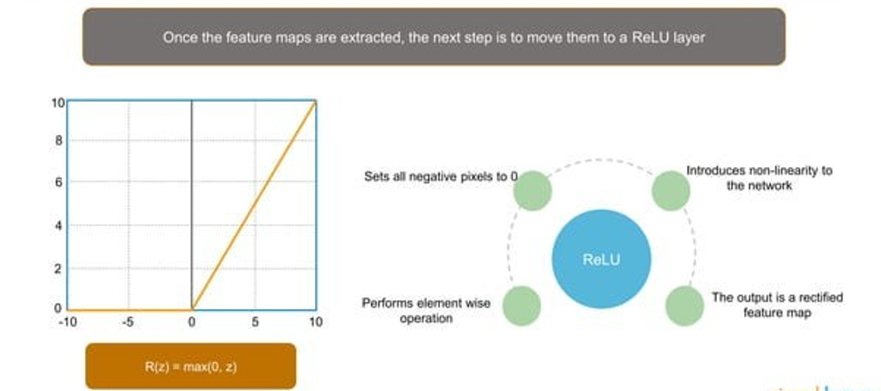
ReLU Layer

Slide 41
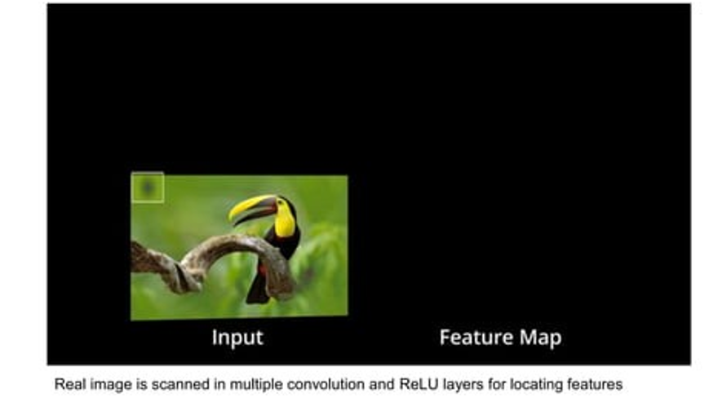
ReLU Layer

Slide 42
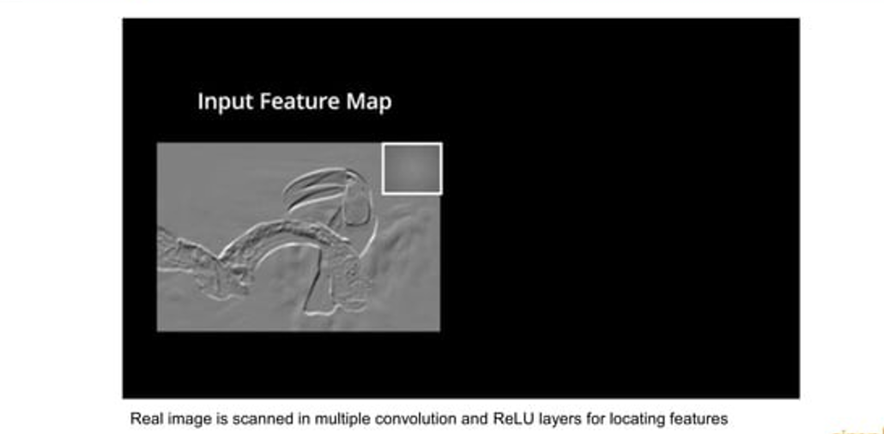
ReLU Layer

Slide 43
Pooling Layer
In a CNN (Convolutional Neural Network), a pooling layer is a type of layer that reduces the size of the input data by applying a pooling operation. This operation typically involves dividing the input data into non-overlapping regions, and then computing a summary statistic for each region (e.g. the maximum or average value). This has the effect of reducing the dimensionality of the data and making the network more efficient. The pooling layer is often used after the convolutional layer in a CNN, and it can help to make the network more robust to small translations and deformations in the input data.

Slide 44
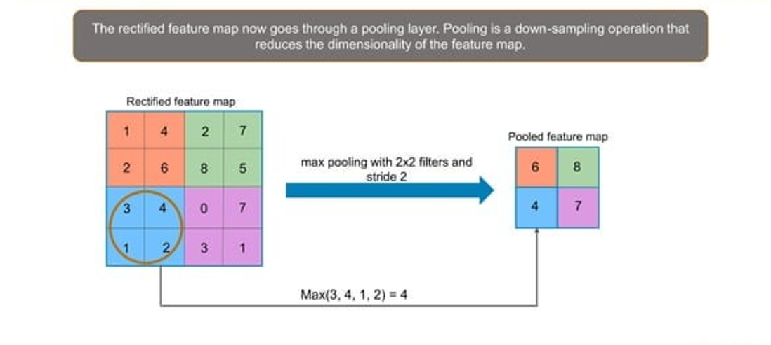
Pooling Layer

Slide 45
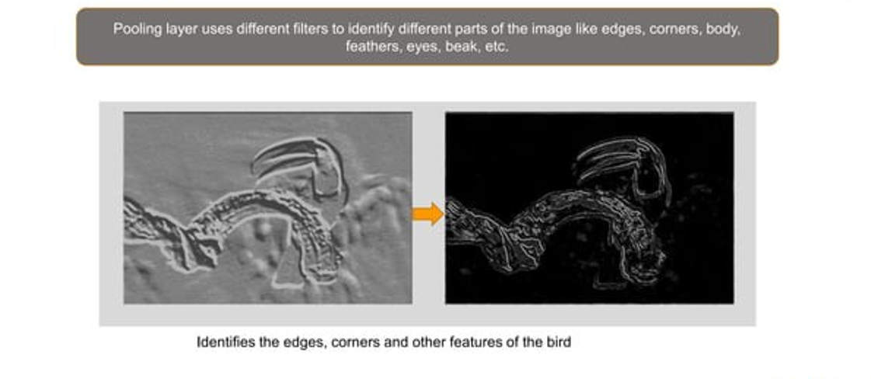
Pooling Layer

Slide 46
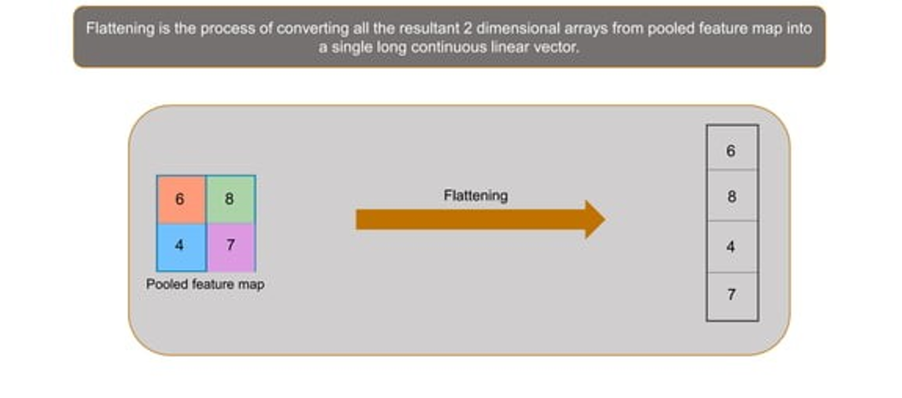
Flattening

Slide 47
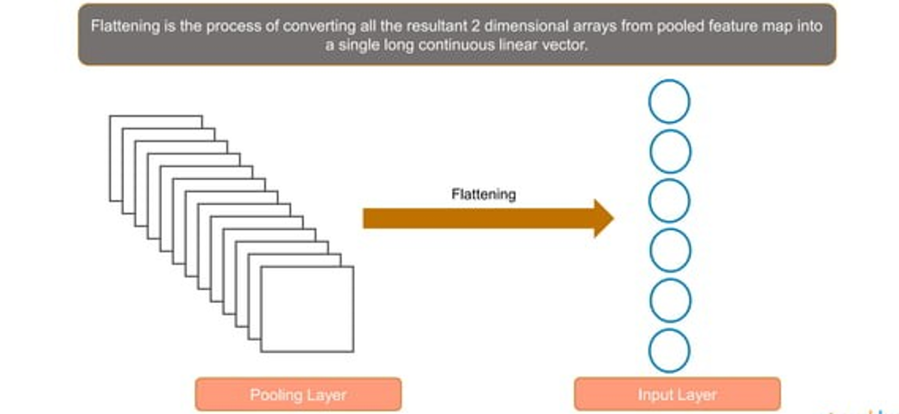
Flattening

Slide 48
Fully-Connected Layer
In a CNN (Convolutional Neural Network), a fully-connected layer is a type of layer that is connected to all units in the previous layer. This means that each unit in the fully-connected layer receives input from every unit in the previous layer, and its output is determined by a weighted sum of these inputs. The weights of the connections are learned during training, and they determine how the fully-connected layer processes the input data to produce an output. The fully-connected layer is often used at the end of a CNN, and it can help to combine the features extracted by the earlier layers to produce a final output that can be used for tasks such as image classification

Slide 49
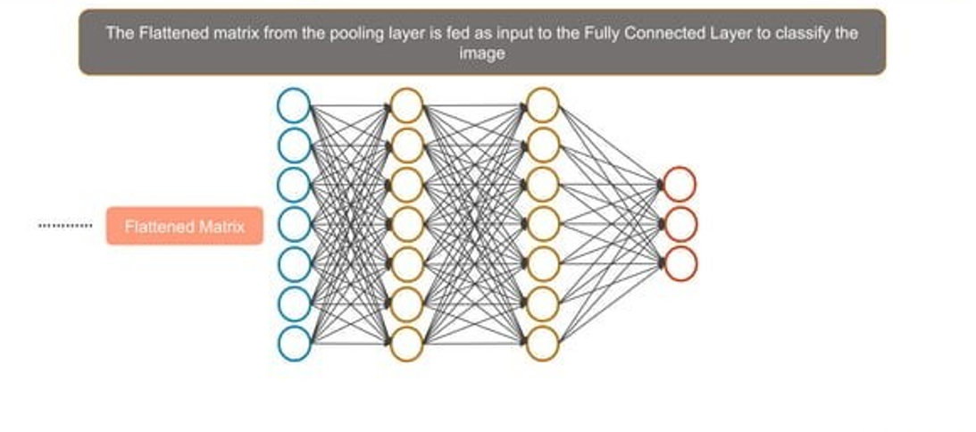
Fully Connected Layer

Slide 50
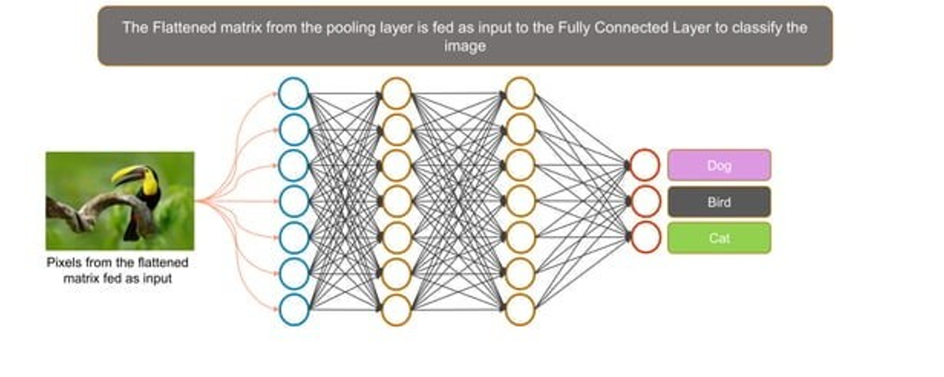
Fully Connected Layer

Slide 51
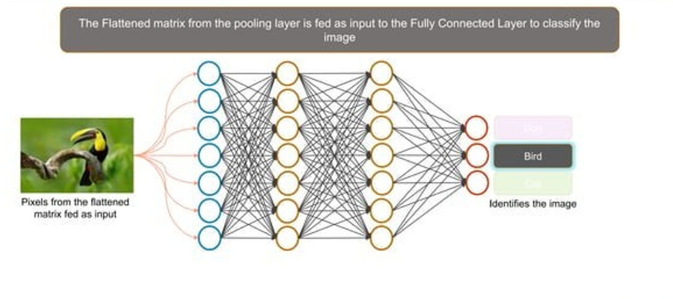
Fully Connected Layer

Slide 52
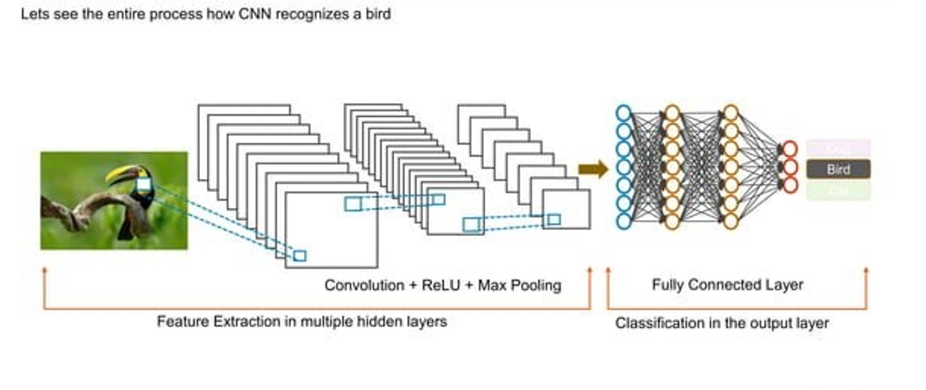
Fully Connected Layer

Slide 53
SVC(Support Vector Classification)
SVMs are a type of supervised learning algorithm that can be used for classification or regression tasks.
SVMs work by finding a hyperplane that separates the data points into two classes
The hyperplane is the line or plane that best separates the data points with the maximum margin.

Slide 54
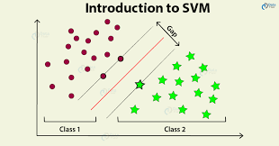
SVC(Support Vector Classification)
SVMs are known for their high accuracy and robustness to noise.
SVMs are often used for tasks such as image classification, text classification, and fraud detection

Slide 55
SVC Advantages
High accuracy
Robust to noise
Can be used for both classification and regression tasks
Can be used with a variety of data types

Slide 56
SVC Disadvantages
Can be computationally expensive to train
Can be sensitive to hyperparameters
Not always the most interpretable model

Slide 57
ROC Curve
A Receiver Operating Characteristic (ROC) curve is a graphical representation of the performance of a binary classification model. It illustrates the trade-off between the true positive rate (sensitivity) and the false positive rate (1-specificity) at various classification thresholds.
The ROC curve provides a visual assessment of the classification model's discriminatory power and allows for the selection of an appropriate classification threshold based on the desired balance between true positives and false positives.

Slide 58
Python Language
Python is a programming language that supports the creation of a wide range of applications. Developers regard it as a great choice for Artificial Intelligence (AI), Machine Learning, and Deep Learning projects.
It has a huge number of libraries and frameworks: The Python language comes with many libraries and frameworks that make coding easy. This also saves a significant amount of time.

Slide 59
Advantages of proposed System
With this system we can verify the user image.
We can also get the probability of similarity of saved image.
It will be simple to find the person Skin disease.
It also reduce our time and efforts to Skin disease.

Slide 60
System Requirement
Hardware Requirements
Processor: Intel core i3 processor or higher.
An AMD equivalent processor will be optimal.
RAM: 4 GB minimum, 16 GB or higher is recommended.
System type: 32-bit, 64-bit Windows 7 and higher.
Hard Disk: 512gb minimum
Software Requirements
Programming language: Python
IDE : Google Colab
Algorithm : CNN(Convolutional Neural Network)
Machine Learning Library :- Tensorflow , Keras , Pandas

Slide 61
References
https://www.ncbi.nlm.nih.gov/pmc/articles/PMC4963704
Sharma P.V., Samhita Susruta, Varanasi . 2010. Chaukhambha visvabharati. [Google Scholar]
Srikantha Murthy K.R., Astanga Hrdayam of Vagbhata; Varanasi . 2005. Chowkhamba Krishnadas Academy. [Google Scholar]
Sharma R.K., Dash Bhagwan, Samhita Caraka, Varanasi . 2018. Chaukhambha Sanskrit Series Office. [Google Scholar]
https://www.dailypioneer.com/2022/india/19-20-lakh-cancer-cases-reported-in-india-in-2022.html

Slide 62
THANK YOU

